Slide 1
NTHU Introduction to ML 2024
Lab 1 Grip Force Prediction using Regression
Jui-Yun Su
Po-Chih Kuo

Slide 2
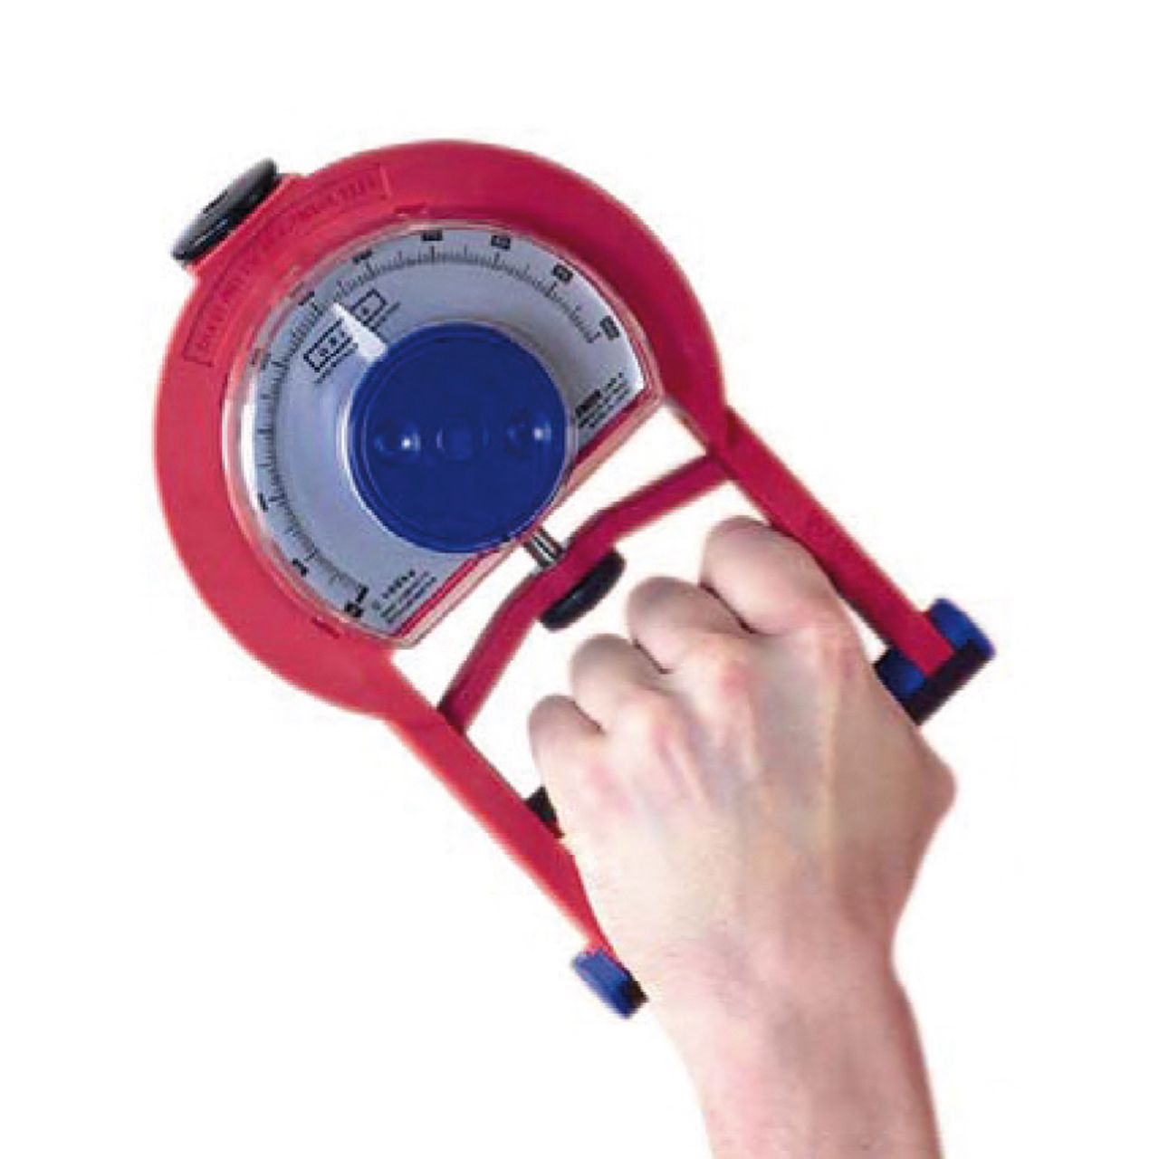
Introduction
Understanding human body performance is critical for various applications, from health monitoring to sports science. Factors such as age, gender, height, weight, body fat percentage, and blood pressure can all influence physical capabilities, including grip strength.
In this lab, students will need to develop predictive models to accurately estimate one’s grip force based on the body data.

Slide 3
Google Colab
We use .ipynb file
If you don’t have the environment to run .ipynb files, we recommend you to use Google Colab
You can also use other tools to compile the .ipynb files, such as Jupyer Notebook or VScode

Slide 4
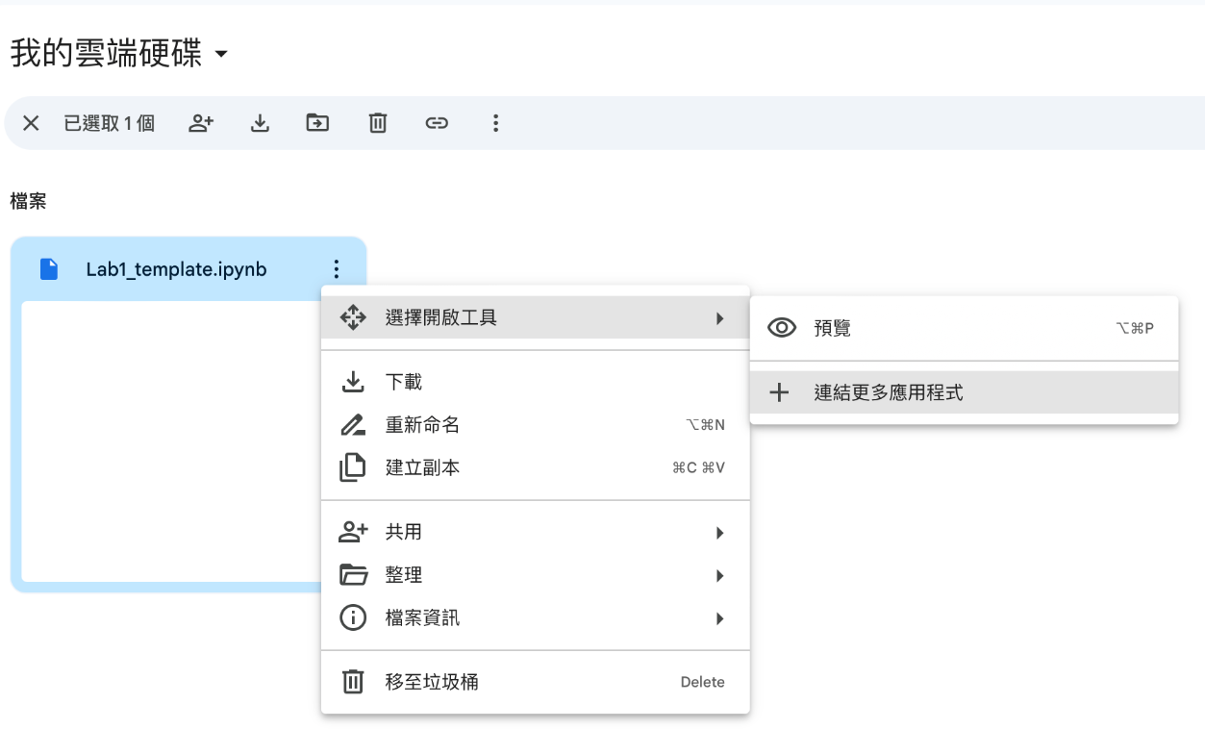
Google Colab
Upload the file to google drive
Right click -> Open with -> Connect more apps

Slide 5
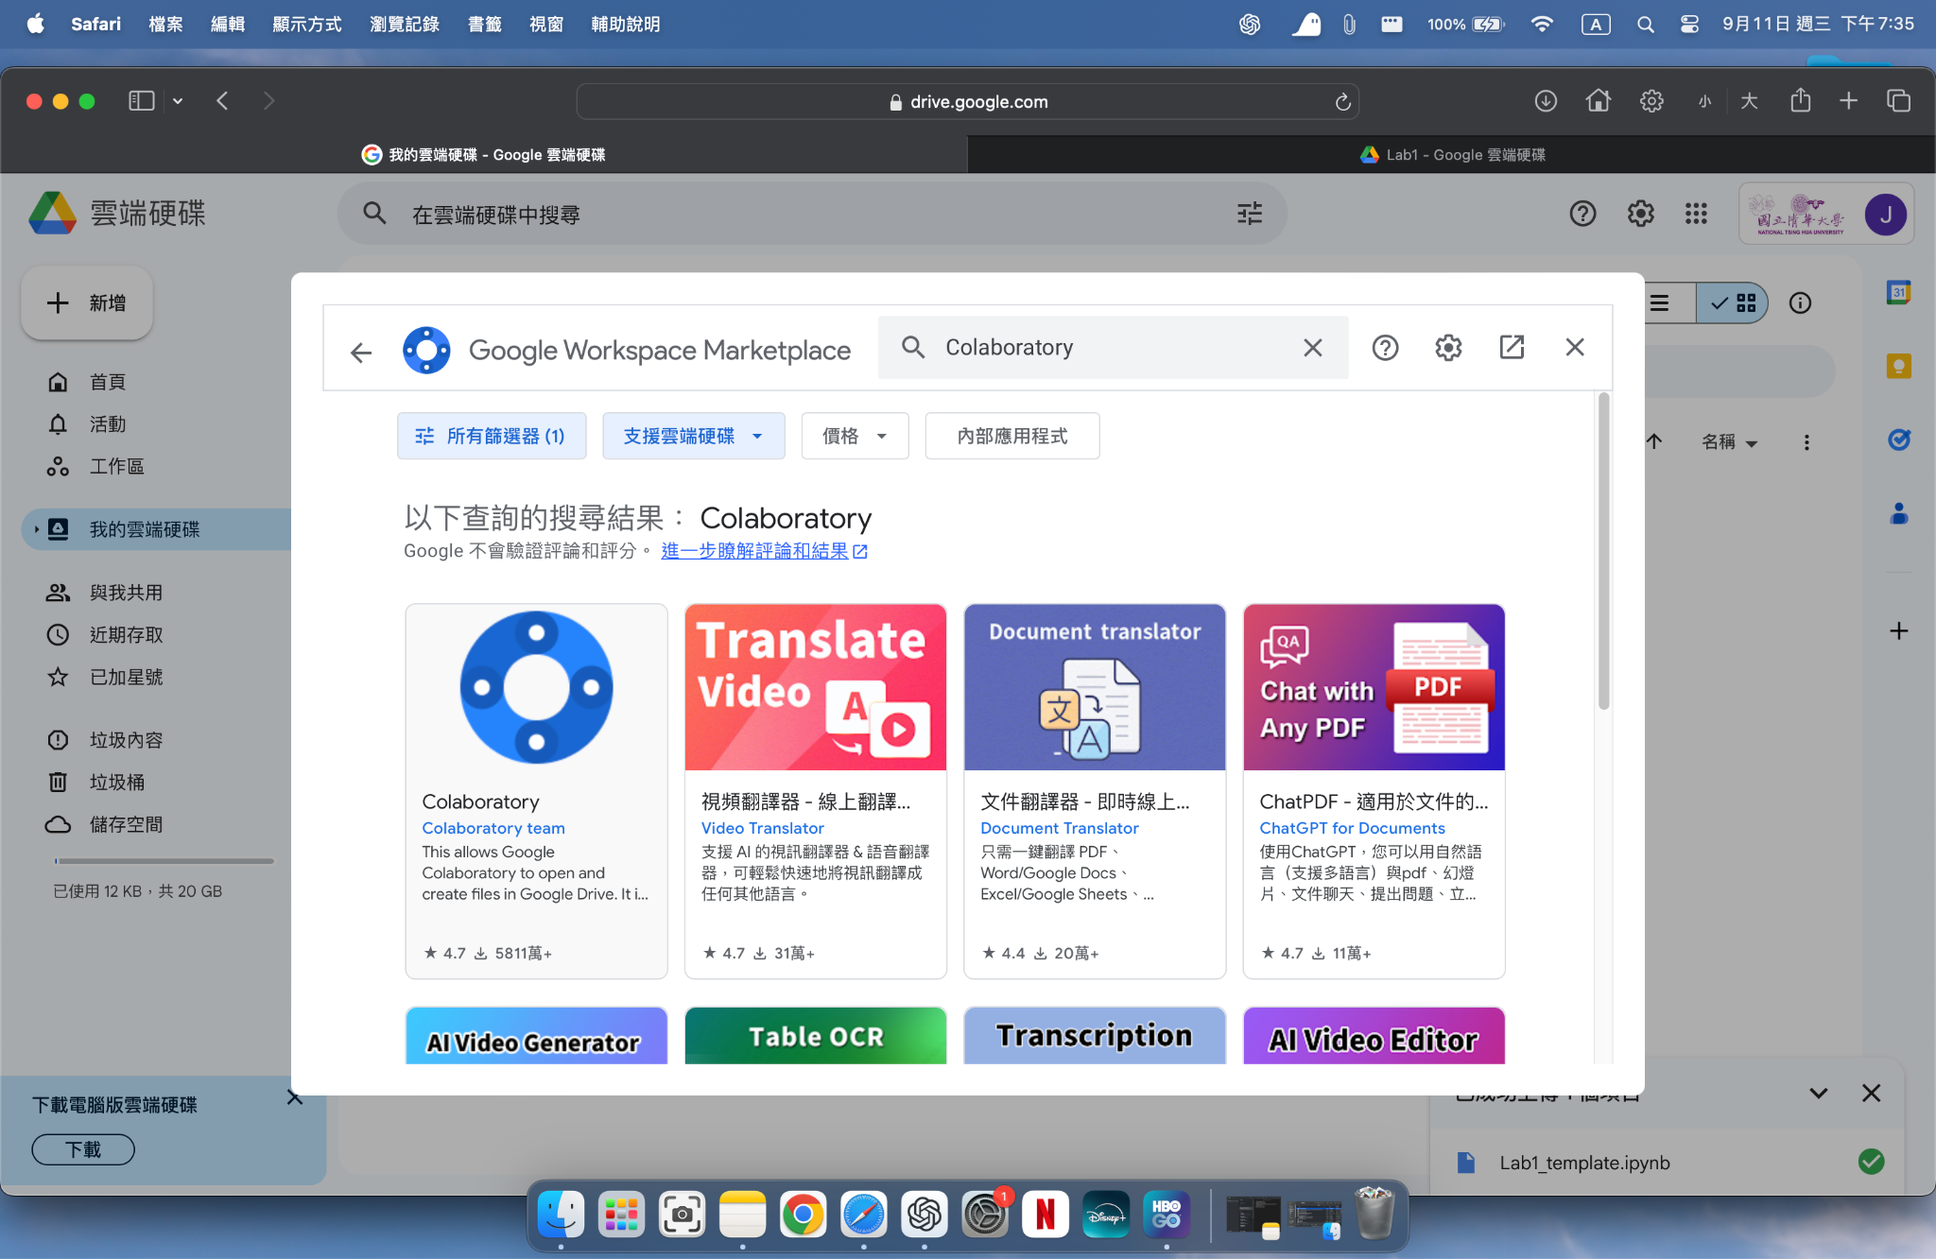
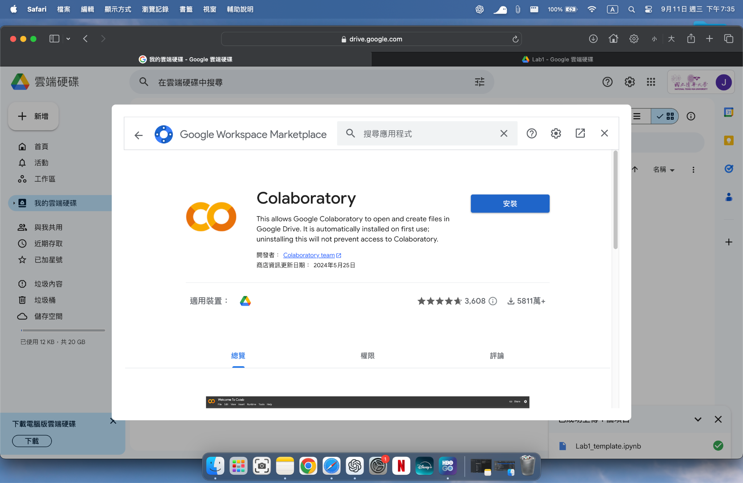
Google Colab
3. Search for “Colaboratory” , and install. Now you can use Colab to open the .ipynb file

Slide 6
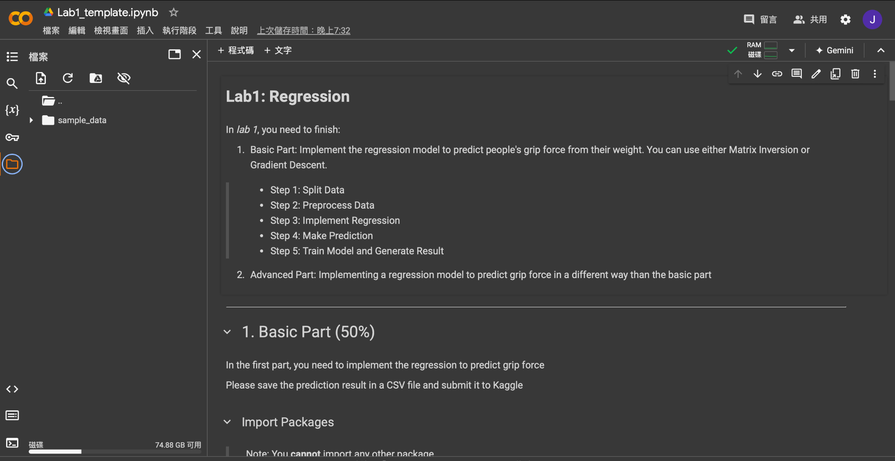
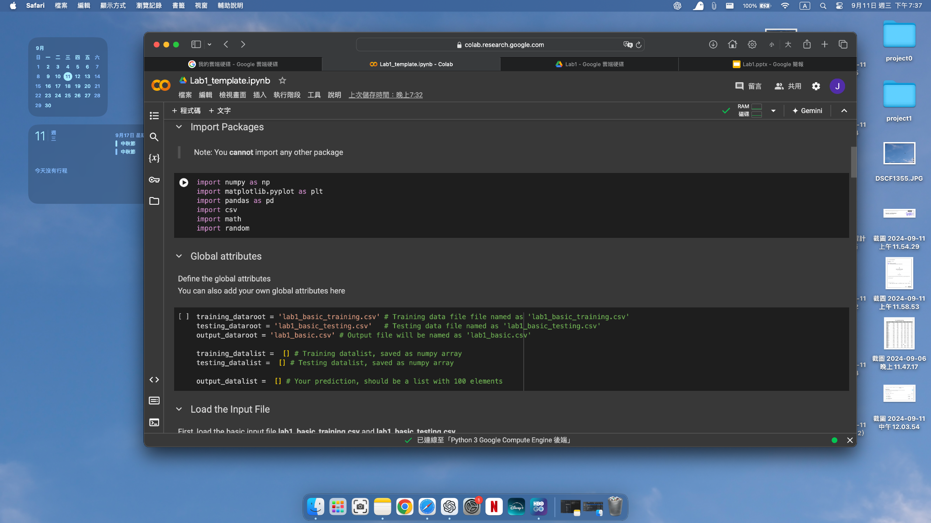
Google Colab
4. After opening the file, you can upload other files (e.g. datasets) so you can
access them from your program. You can also mount your google drive
5. Click the “run” button to execute your code
upload file mount google drive

Slide 7
Dataset
Body measurement data
Parts of data have been manipulated
Outliers and missing values(‘nan’) were added
Only in training dataset
Attributes
age
gender
height
weight
bodyFat
diastolic
systolic
gripForce

Slide 8
Goal
Predict grip force based on an individual’s weight
Combine other variables such as age, gender, and height to improve the prediction of grip force
Implement a regression model to make these predictions, and preprocess/split the data for model training and testing.

Slide 9
Grading Policy
Item | Score
Basic Implementation | 50%
Advanced Implementation | 45%
Report | 5%

Slide 10
Basic Implementation (50%)
Given 10,000 subjects’ body weight and grip force
Implement gradient descent to build a regression model using body weight as the input variable to predict grip force
Please use the provided file as your input and submit your predictions to Kaggle (link in Page 19)

Slide 11
Basic Grading Policy
Baseline – 50%
Submit the answer (.csv) to Kaggle ML2024-Lab1-BasicPart
Get all if MAPE <= 25%

Slide 12

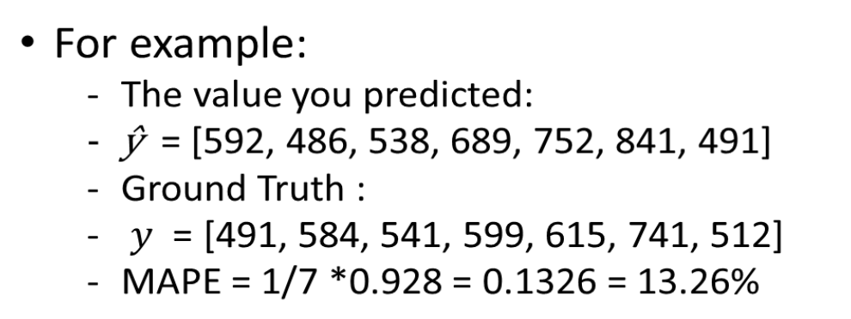
The Evaluation Metric
MAPE (Mean absolute percentage error)

Slide 13
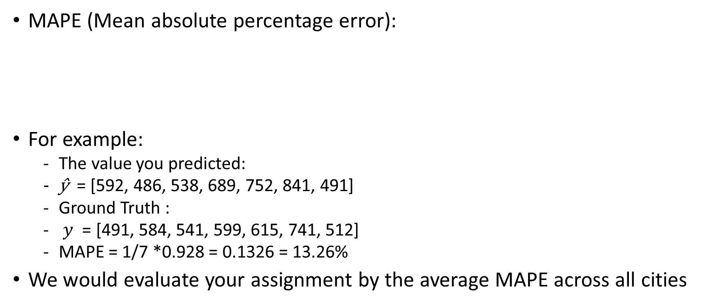
The Evaluation Metric

Slide 14
Advanced Implementation (45%)
Combine with other conditions or modify the approach from the basic model to improve your predictions
You may complete this part in any way you prefer, including using matrix inverse, but do not import additional modules.
Using only body weight (as done in the basic part) will not earn points
Please use the provided file as your input and submit your predictions to Kaggle.

Slide 15
Advanced Grading Policy
Baseline – 35% (There are 3 baselines to beat)
MAPE < 22% => 20% (1st baseline)
MAPE < 20% => 10% (2nd baseline)
MAPE < 17% => 5% (3rd baseline)
Ranking –10%
Compete your MAPE with the whole class
Submit the answer (.csv) to Kaggle ML2024-Lab1-AdvancedPart

Slide 16
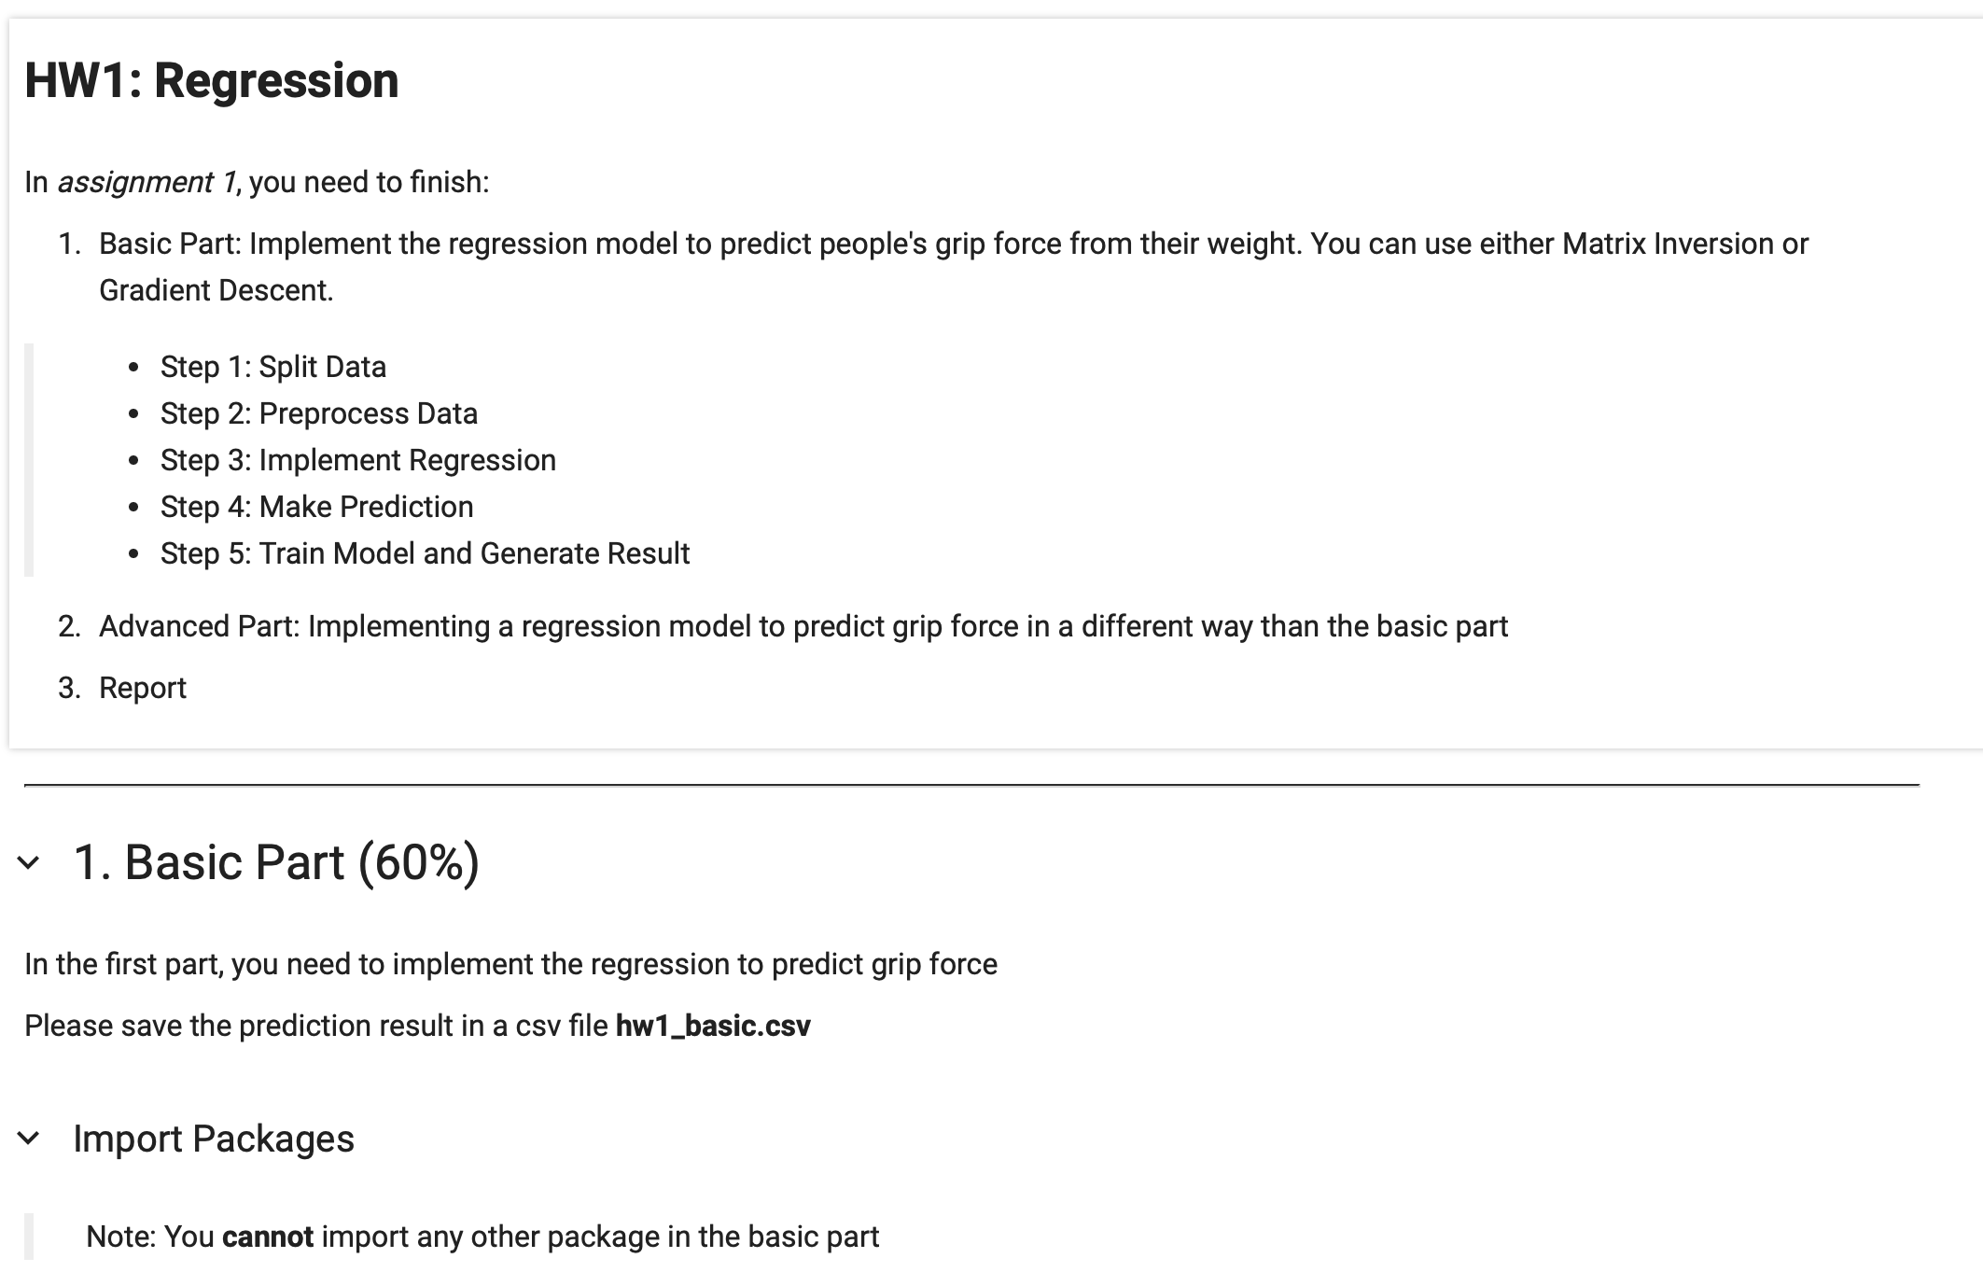
Template
You must use the given file “Lab1_template.ipynb” to build the model
Except for the imported packages in the template, you may not use any additional packages in both the basic and advanced parts.

Slide 17
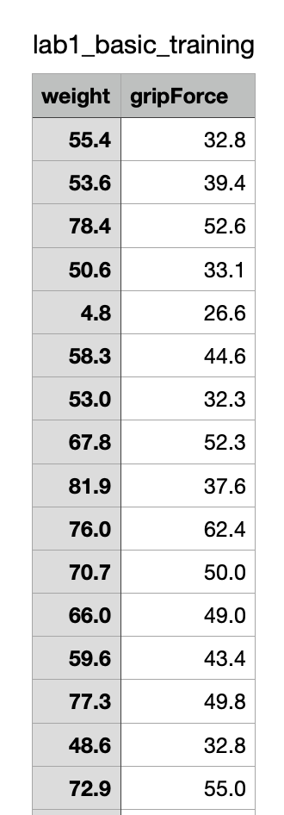
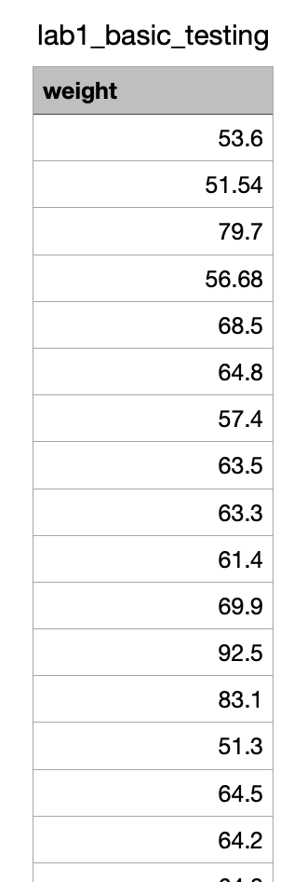
Basic Input File Format
There will be two input files:
“lab1_basic_training.csv
Each row has weight and gripForce
Contains (10000 +1) rows
“lab1_basic_testing.csv”
Doesn’t have the gripForce column
Contains (100+1) rows

Slide 18
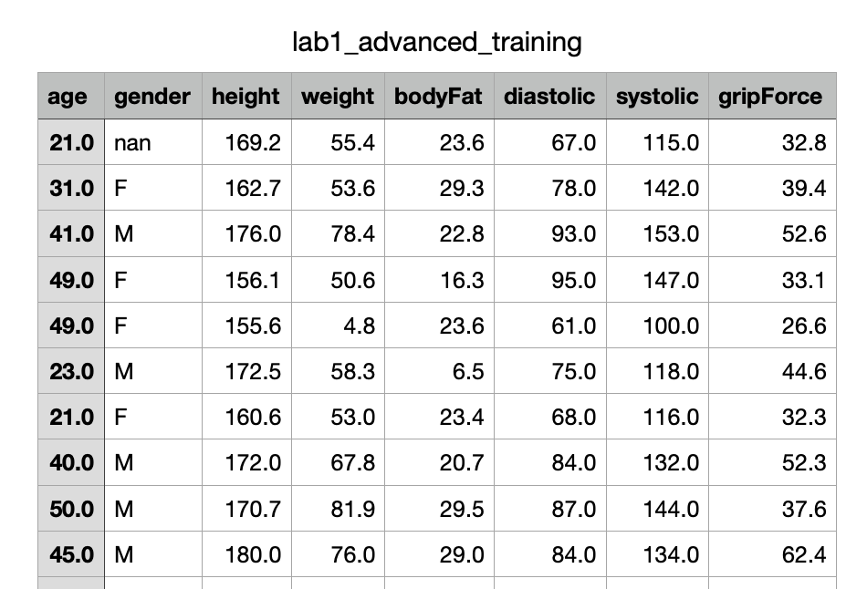
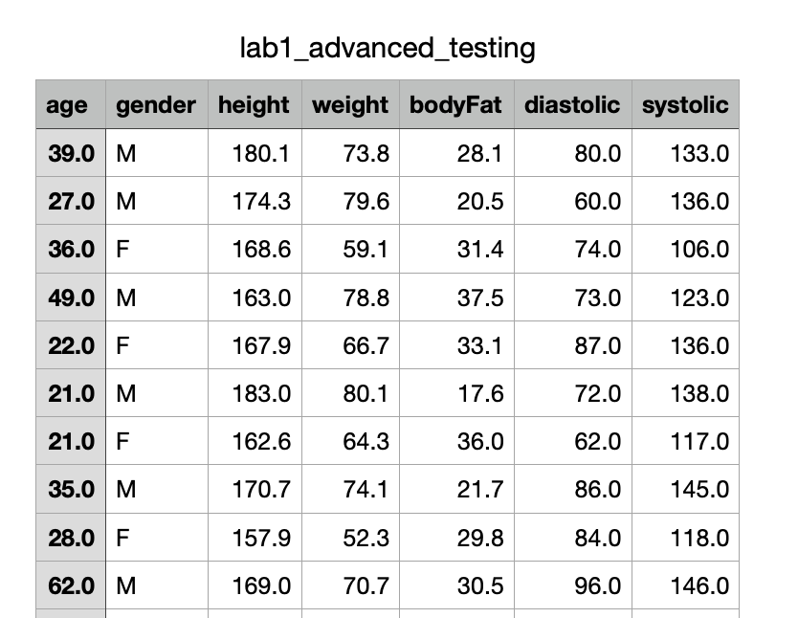
Advanced Input File Format
There will be two input files:
“lab1_advanced_training.csv”
Each row has “age, gender, height, weight, body fat, diastolic, systolic, and gripForce”
Contains (10000 +1) rows
“lab1_advanced_testing.csv”
Doesn’t have the gripForce column
Contains (3000+1) rows

Slide 19
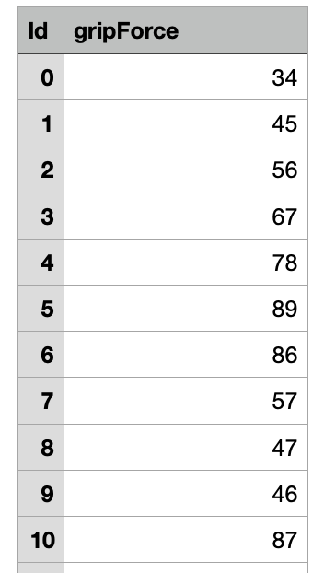
Output File Format
The prediction of both basic and advanced you submit to Kaggle must follow this format
File names are not restricted
Prediction for basic part should have 100+1 rows, and predictions for advanced part should have 3000+1 rows
The first row is the header [“Id”, “gripForce”]
Id starts from 0, and gripForce is the predicted answer
Please make sure your model can correctly output this format of csv file

Slide 20
Kaggle
We’ve created two competitions for Basic & Advanced part respectively.
Basic part link: https://www.kaggle.com/t/94e9d46e5923438ebc4ef5b4d6bb3270
You can check if you pass the baseline directly.(50%)
Advanced part link: https://www.kaggle.com/t/f833b5c488d14f8581ce76fe4ec68228
In advanced part, we split data into public & private two parts.
In public score, we have three baselines that you can also check if you get the points.(35%)
Private score is for ranking. The private score would be revealed after deadline.(10%)

Slide 21
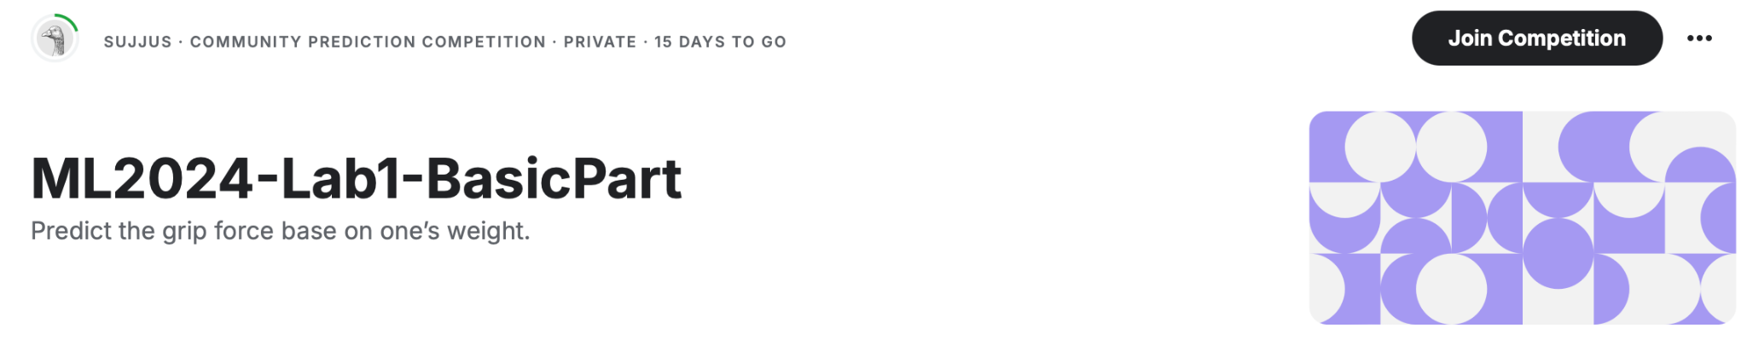
Kaggle
Please register your account.
Click the ‘Join competition’ button to join.

Slide 22
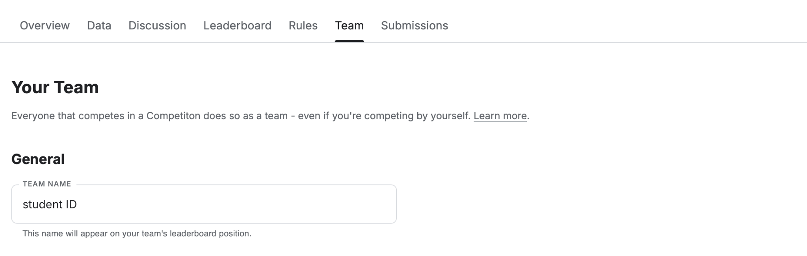
Kaggle
After joining the competition, you should change your team name (each student is a team) to your student ID.

Slide 23
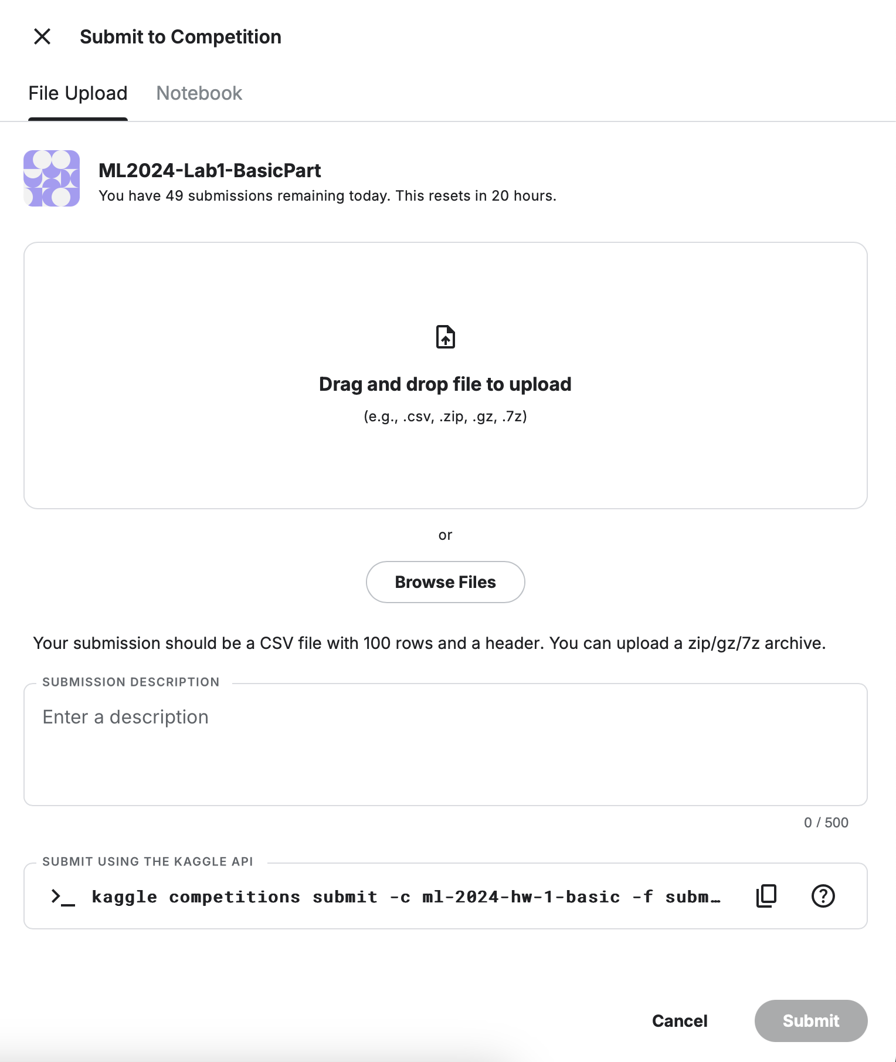
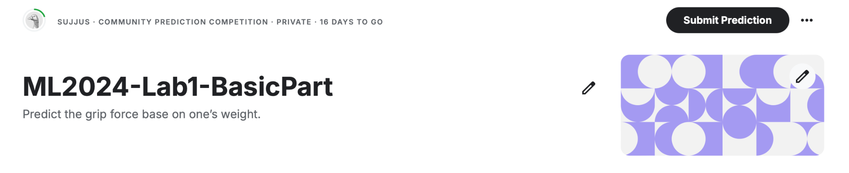
Kaggle
Click the “Submit Prediction” button and upload your prediction file, then you will see your MAPE score
You can submit 50 times per day.

Slide 24
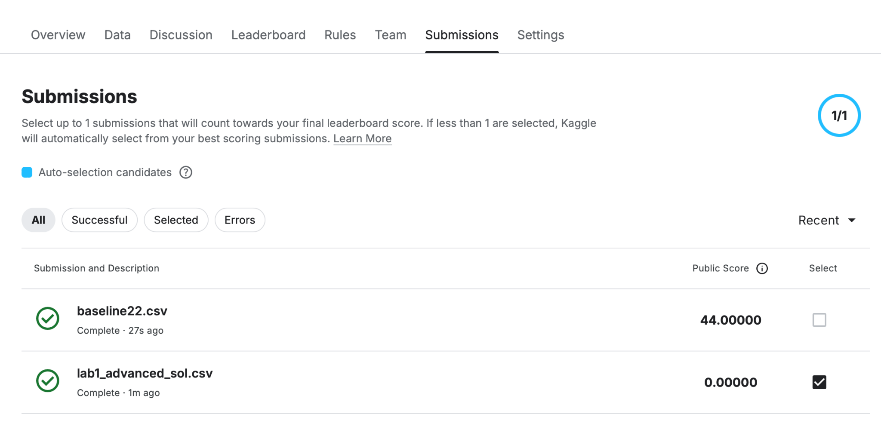
Kaggle (optional)
For advanced part, you can choose one of your predictions to compete with others
If you don’t make a selection, the system will automatically choose the one with the best public score

Slide 25
Report
Named as “Lab1_report.pdf”
Write down your regression equation in basic part (1%)
Briefly describe the variables and the regression equation you used in the advanced part (2%)
No point would be given for the advanced part if you do not clearly point out the difference between the basic part and the advanced part
Briefly describe the difficulty you encountered (1%)
Summarize how you solve the difficulty and your reflections (1%)
No more than one page

Slide 26
Lab 1 Requirement
Do it individually! Not as a team! (The team is for final project)
Announce date: 2024/9/12
Deadline: 2024/9/26 23:59 (Late submission is not allowed!)
Submit the answers (csv) to corresponding Kaggle competition.
ML2024-Lab1-BasicPart
ML2024-Lab1-AdvancedPart
Hand in following files to eeclass in the following format (Do not compressed!)
Lab1.ipynb
Lab1_report.pdf
5 Points would be deducted if your submission format is incorrect
Lab 1 would be covered on the exam next time.

Slide 27
Penalty
0 points if any of the following conditions happened
Plagiarism
Late submission
Not using a template or importing any other packages in the basic part
No submission record on Kaggle
Your submission was not generated by your code

Slide 28
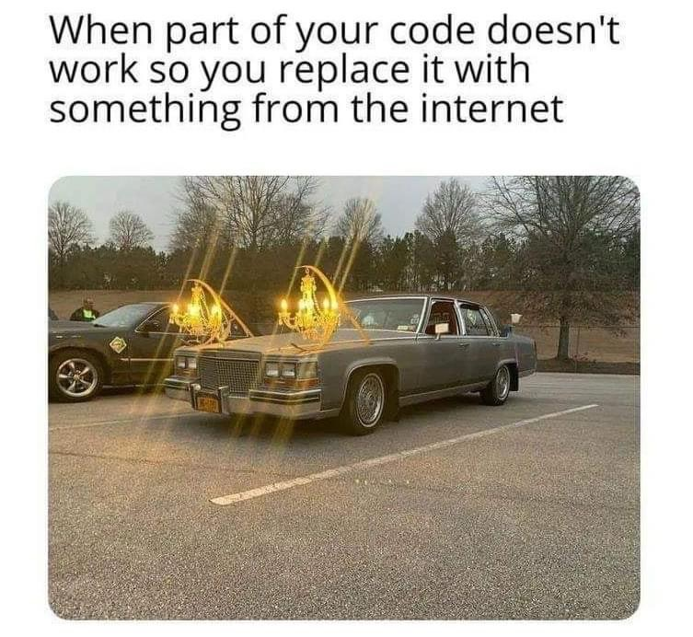
Questions?
TA: Jui-Yun Su (ss113062515@gapp.nthu.edu.tw)
Please do not ask for debugging.

